Slide 1



PRP + DERMAROLLER + LLLT @ ₹3,000 Only
Call @ 78369-10003

Slide 2



Unique
Elegance

Slide 5

Healthy
Life
Code

Slide 6



Top 10 Best Website Builders

Slide 7
We Offer
IT Development, Consultancy & Digital Marketing Solutions
View Portfolio

Slide 8



Create FREE Business Email With

Slide 9

Python map() Function

Slide 10

Best FTP Clients

Slide 11

Free Blogging Websites

Slide 12

Best Timings To Post On

Slide 13
ਦੋਸਤੀ ਉਹਨਾ ਨਾਲ ਕਰੋ ਜੋ ਨਿਭਾਉਣਾ ਜਾਣਦੇ ਹੋਣ ਨਾ ਕਿ ਓਹਨਾ ਨਾਲ ਜੋ ਸਿਰਫ ਕੱਮ ਕਢਵਾਉਣਾ ਜਾਣਦੇ ਹੋਣ

Slide 14


M
School

Slide 15

Education
Icon Awards

Slide 16

Website Development
Call @ 70097-73509

Slide 17

GYM Website
Development
Call @ 70097-73509

Slide 18

E-Commerce Website
Development
Call @ 70097-73509

Slide 19

SHOP Website
Development
Call @ 70097-73509

Slide 20

SCHOOL Website
Development
Call @ 70097-73509

Slide 21

Mobile App
Development
Android, iOS, Windows & PWA
Call @ 70097-73509

Slide 22


Review

Slide 23

Review

Slide 24

Managed WordPress Hosting Review

Slide 25
Backup & Restore WordPress Website

Slide 26
Dedicated Web Hosting Review

Slide 27
Dedicated Web Hosting Review

Slide 28

Shared Web Hosting Review

Slide 29
Windows Shared Hosting Review

Slide 30
Cloud
Hosting Review

Slide 31

Plagiarism Checker Tools

Slide 32

Review

Slide 33

Discount Codes

Slide 34

Review

Slide 35

Review

Slide 36

Review

Slide 37


Review

Slide 38
Digitalकक्षा
Digital Marketing Training Modules
Duration – 60 Hours (2 Months Course)
Digital Marketing Introduction & Overview (2 Hours)
SEO – Search Engine Optimization (10 Hours)
SEM – Google AdWords (Display + Search Ads) (3 Hours)
SMO – Facebook, Twitter, Instagram (5 Hours)
YouTube Viral Video Ranking & Promotion (2 Hours)
Email Marketing From Scratch (3 Hours)
Lead Generation For Business (3 Hours)
Website Optimization + Traffic Conversion (4 Hours)
Competitor Analysis and Business Strategies (3 Hours)
E-Commerce Setup and Promotion (2 Hours)
Online Branding and Reputation Management (2 Hours)
Online Marketing Tools and Usage (4 Hours)
Content Marketing To Build Brand (2 Hours)
Home Business Setup (AdSense, Affiliate, Freelance Work) (5 Hours)
AdWords + Facebook Certification (10 Hours)
Course Fee - ₹ 30,000 (2 Installments)
Call @ 96750-33525, 96344-83287

Slide 39
Digitalकक्षा
SEO Training Modules
Duration – 20 Hours
Introduction (2 Hours)
Keyword Research (2.5 Hours)
ON-Page SEO (2 Hours)
OFF-Page SEO + Anchor Rules (3.5 Hours)
Competitor Analysis (2 Hours)
SEO Rules & Strategies (2 Hours)
Negative SEO To Avoid (1 Hour)
Use of SEO Tools (2 Hour)
Local SEO (2 Hour)
Top 10 Rank Formula (1 Hour)
Course Fee - ₹ 20,000 (Online Training)
Call @ 96750-33525, 96344-83287

Slide 40

Review

Slide 41

Website Builder
Review

Slide 42
Submit URL To Google

Slide 43

How to Start A Blog?

Slide 44


What is Web Hosting?
Services, Types & FAQs

Slide 45

Best Headphones Under ₹500 in India

Slide 46

Best i3 Processor HP Laptops in India

Slide 47
Best i3 Processor HP Laptops in India

Slide 48

BEST
Ranks

Slide 49
Backup WordPress Database With Plugin

Slide 50

How To Create A Blog on Blogger?

Slide 51

Top 10 Programming Languages

Slide 52
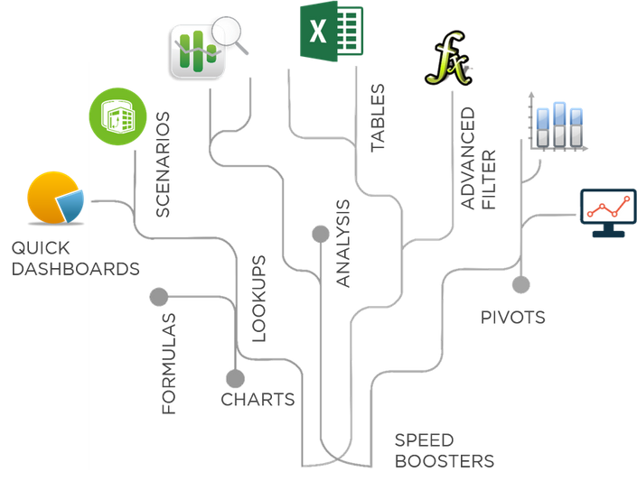

Master Excel Step by Step
30% DISCOUNT

Slide 53

Submit Sitemap To Google

Slide 54

Check if All Items in
Ietrable are True or Not
all( ) function

Slide 55

On-Page
SEO

Slide 56
Free 7 Day Trial

Slide 57

Free Online Grammar Checker Tools

Slide 58
QR Code Generator
By

Slide 59

Affiliate Marketing
Explained

Slide 60
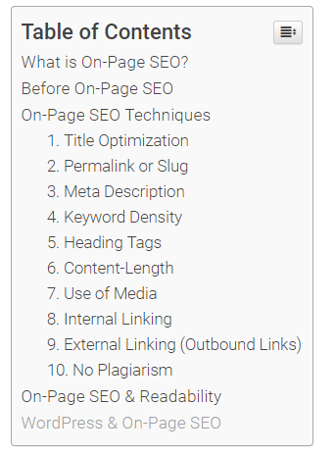
Automatic Table of Contents In WordPress

Slide 61
Plagiarism Checker Review

Slide 62


Write Better With
Proofreading + Grammar Enhancement

Slide 63
Cheap Web Hosting
List of Best Web Hosting
Services with Affordable Pricing

Slide 64

Best WordPress Hosting Services

Slide 65

Dedicated Server Hosting

Slide 66

Make Money Online

Slide 67
Google Keyword Planner

Slide 68

Free Web Hosting

Slide 69

Best VPS Hosting

Slide 70
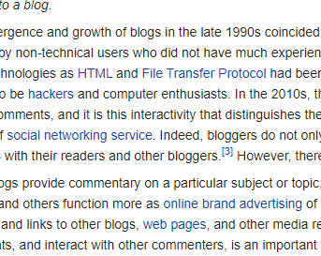

Backlinks

Slide 71
GUEST POST
अपनी रचना जैसे कि निबंध, कविता, कहानी आदि हमें भेजें । हम उसे HindiVidya पर Publish करेंगे, और वह भी आपके नाम और जानकारी के साथ ।
अधिक जानकारी .

Slide 72

सुविचार

Slide 73

FTP Client

Slide 74


Cron

Slide 75
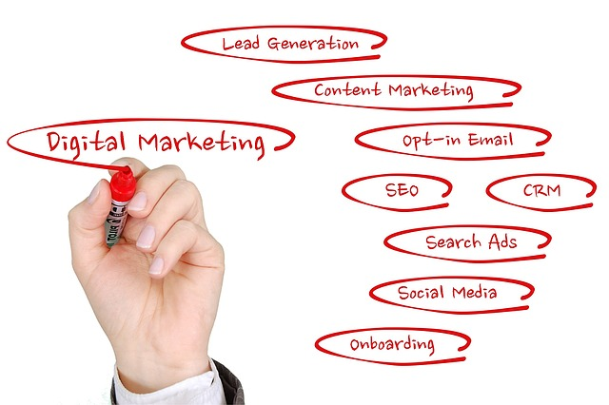



Slide 76



SEO

Slide 77

PHP Redirect

Slide 78

Change Twitter Username

Slide 79
WordPress Redirects

Slide 80

Blog
&
Blogging

Slide 81

How To Use Google Fonts in your Website?

Slide 82
Fix Error Establishing A Database Connection

Slide 83



JPG vs PNG Images

Slide 84
Tutorial To Install Plugins in WordPress

